Slide 1


Slide 2
Course
Problem Solving and Programming Using C
Lecture Details:
Topic-1: Basics of C Programming(Unit-1)
B.Tech, I Semester

Slide 3
Contents
What is C ?
Why do we use C ?
History of C Language
Features of C Language
Program Development Steps
Structure of a C program
Header files and Processor Directives
Steps for Creating and Executing C Program

Slide 4
What is C ?
C is a general-purpose programming language
C is also said to be structured programming language
C is a function oriented programming language
C is a high level programming language

Slide 5
Why do we use C ?
C language is used to create applications or software
Initially, C was developed to create an operating system called UNIX
The popular software like Linux OS, PHP & MySQL are created using C language

Slide 6
Why do we use C ?
Generally C Language is used to create the following…
Operating Systems
Language Compilers
Assemblers
Interpreters
Text Editors
Network Drivers
Databases

Slide 7
History of C Language
Developed by Dennis Ritchie in the year of 1972
Born – September 9, 1941
Profession – Computer Scientist
Place – Bell Labs, US
Known As – Father of C & UNIX
Awards Turing Award(1983)
National Medal of Technology(1998)
IEEE Medal(1990)
Computer Pioneer Award(1994)
Computer History Museum Fellow(1997)
Harold Pender Award(2003)
Died – October 12, 2011
Dennis Ritchie

Slide 8
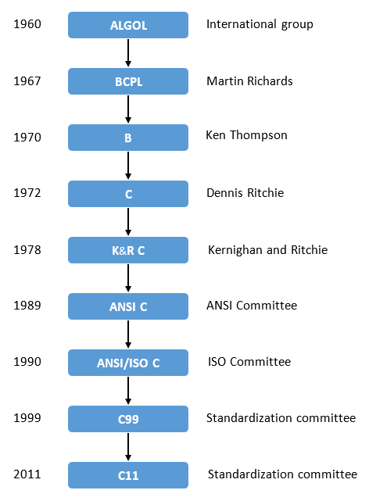
History of C Language

Slide 9
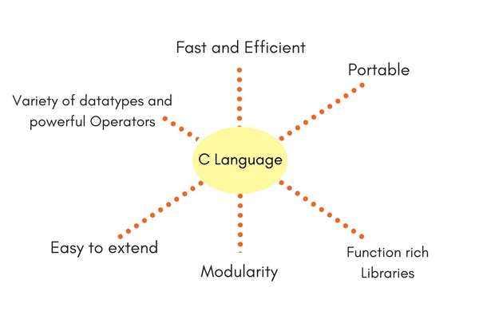
Features of C Language

Slide 10
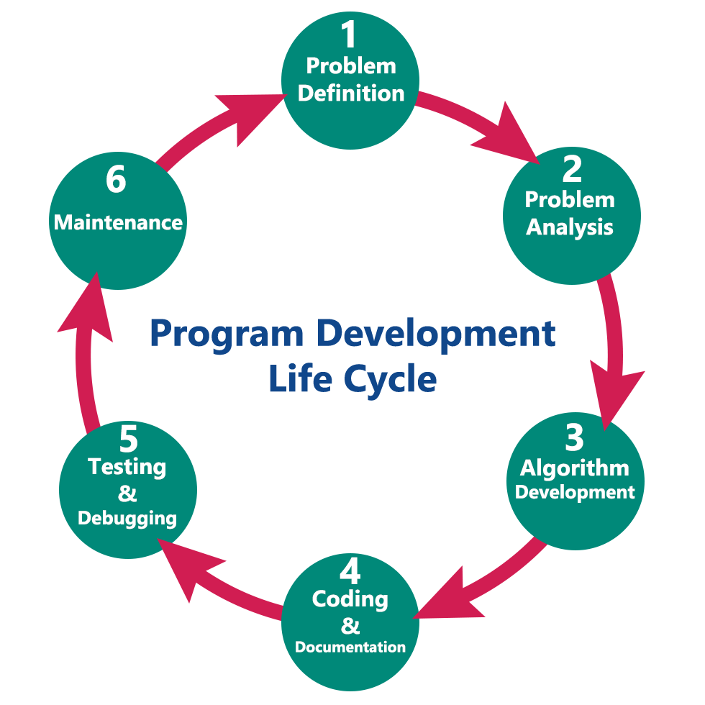
Program Development Steps

Slide 11
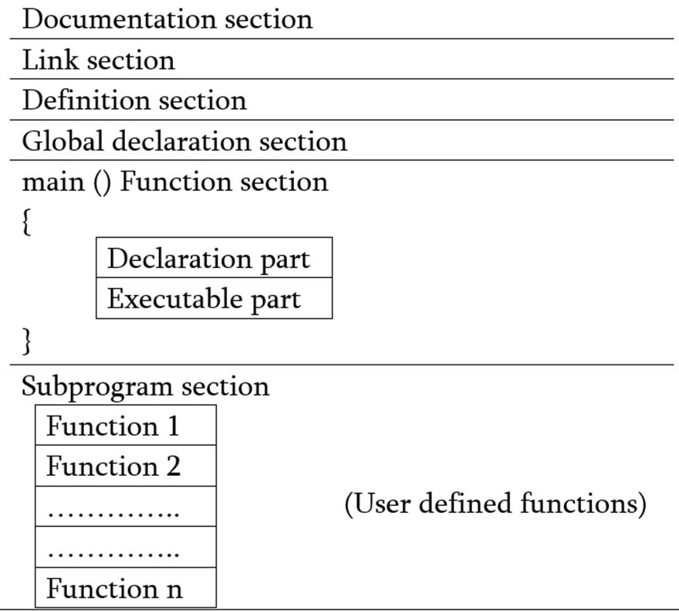
Structure of C Program

Slide 12
Preprocessor Directives
Text processing tool or Text substitution tool.
Begin with a hash symbol #.
Pre-processes the program before the compilation of the program.
A series of textual transformations are done on its input and after that, it will return your C code to the compiler.

Slide 13
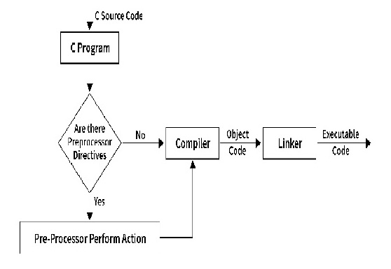
Preprocessor Directives

Slide 14
Preprocessor Directive Types
1. Macros
#define identifier string
#include <stdio.h>
#define PI 3.1415
main()
{
printf("THE VALUE OF PI IS: %f",PI);
}
2. File Inclusion
#include <file name>
#include <stdio.h>
#define PI 3.1415
main()
{
printf("THE VALUE OF PI IS: %f",PI);
}

Slide 15
Preprocessor Directive Types
3. Macros Conditional Compilation
#if, #else, #endif, etc..
#include <stdio.h>
#define Age 18
int main()
{
#ifdef Age
printf("This person is over %d years old.\n", Age);
#endif
printf("So, he is eligible.\n");
return 0;
}

Slide 16
Preprocessor Directive Types
4.Line Control
Syntax 1
# line-number “file_name”
Syntax 2
# line line-number “file_name”
Example
#include <stdio.h>
void function_1();
void function_2();
#pragma startup function_1
#pragma exit function_2
void function_1() {
printf("Inside the function_1()\n");
}
void function_2() {
printf("Inside the function_2()\n");
}
int main() {
void function_1();
void function_2();
printf("Inside the main()\n");
return 0;
}
Output
Inside the main()

Slide 17
Header Files
A file with a .h extension that contains function declarations, macro definitions, and other entities which can be used across multiple C source files (.c files).
This is a powerful feature because it allows programmers to reuse these declarations in several programs, enhancing the code’s maintainability and readability.
#include <stdio.h> // Standard header file
#include "example.h“ // User defined header file

Slide 18
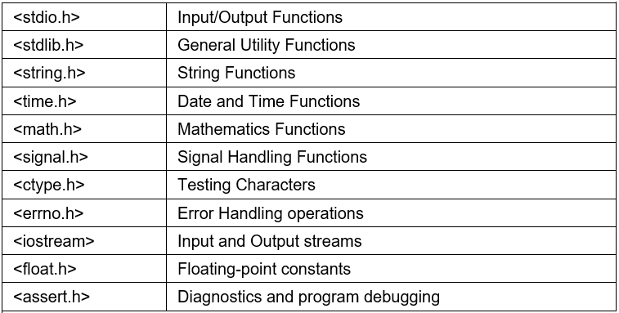
Header Files

Slide 19
Header Files & Preprocessor Directives
Importance of Header Files in C Programming
1. Code Organization
2. Code Reusability
3. Standardization and Portability
4. Efficient Compilation
5. Code Abstraction

Slide 20
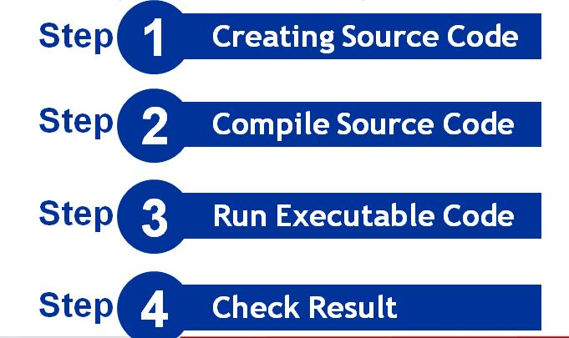
Steps for Creating & Executing C Program

Slide 21
Creating Source Code
Source Code is the file which contains programming
code in high level language
To create source code, we need a text editor to write
the program
In C programming language every source code file
must be saved with “.c” extension

Slide 22
Steps to create source code
Open a text editor
Create New File
Type the program instructions
Save the file with “.c” extension

Slide 23
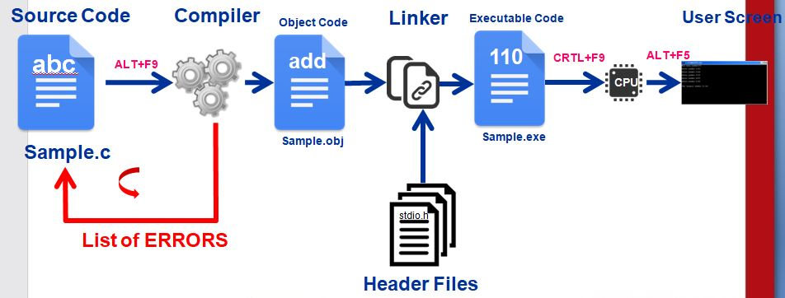
C Program Execution Process

